Slide 1

Data Mining
By: Miles A. Peña
Bellevue University
DSC 500 Introduction to Data Science
Matthew Metzger
November 16, 2023

Slide 2
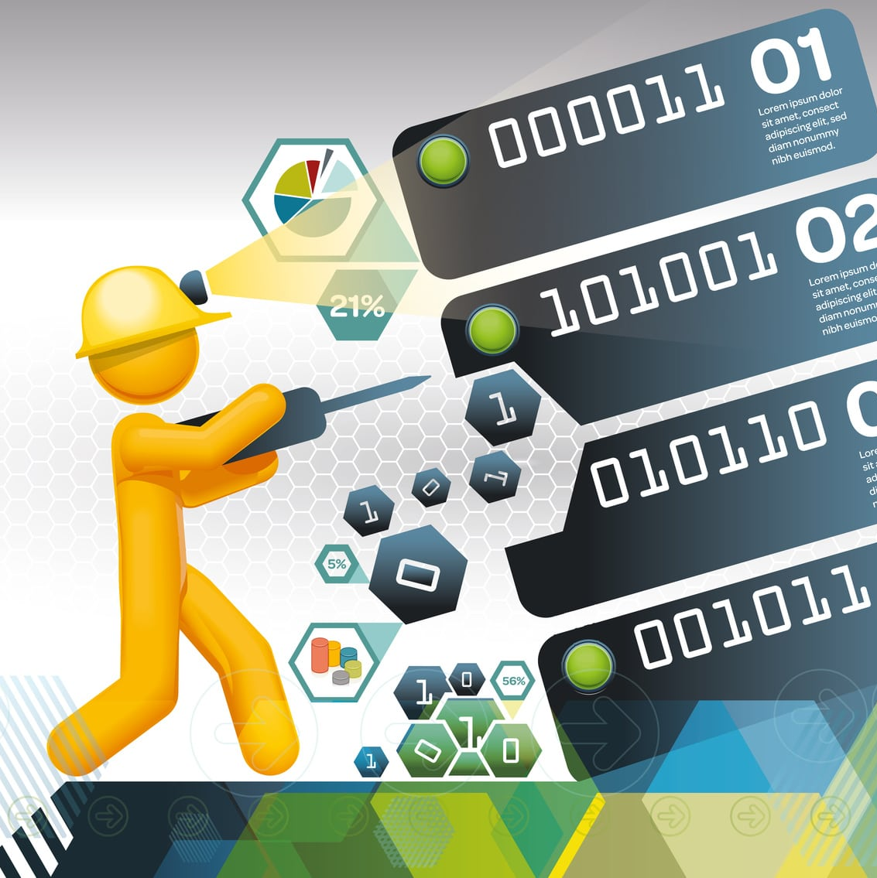
What is it?
Data mining is the process of using computers and automation to search and analyze large sets of data to extract useful information.
It searches for patterns and trends, which are then used to assist with business decisions, insights, and predictions.
Data mining uses data to evaluate future probabilities and develop actionable analyses.

Slide 3

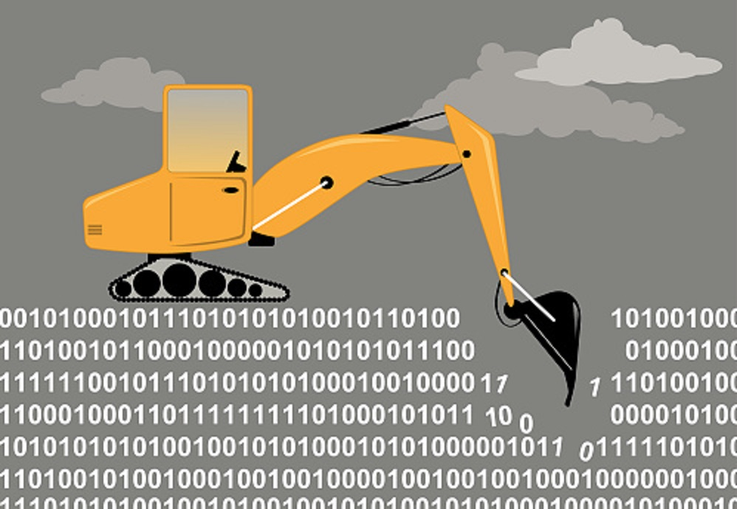
History of data mining
The concept of data mining existed before computers did!
Bayes’ Theorem in 1763 and the discovery of regression analysis in 1803 paved the way for the statistical beginnings of data mining.
the growth of computer processors, data storage, and technology exploded during the 1990s and 2000s allowed data mining to become more powerful and prolific.
Today, data mining plays a crucial role in countless of industries.

Slide 4

Data mining vs. machine learning
Data mining and machine learning are in fact different though they are often perceived to be synonymous.
Machine learning differs in that it is the process of teaching a computer to learn as humans do while again, data mining is the process of finding patterns in the data.

Slide 5
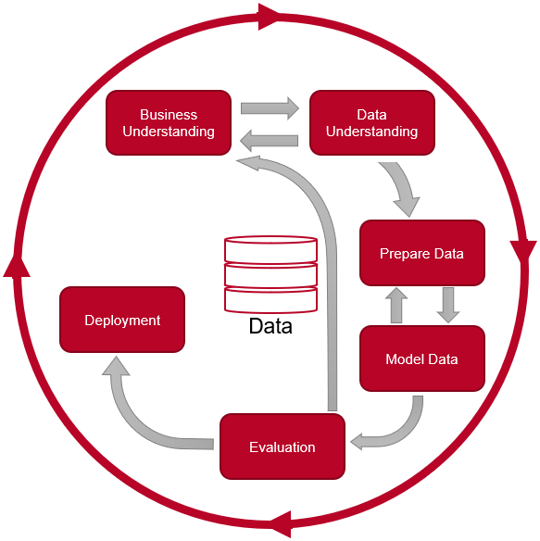
How does data mining work?
Data mining follows a fairly structured, six-step method known as the Cross-Industry Standard Process for Data Mining (CRISP-DM).
This process encourages working in stages and repeating steps if necessary.
Repeating steps is often essential to account for changing data or to introduce different variables.

Slide 6
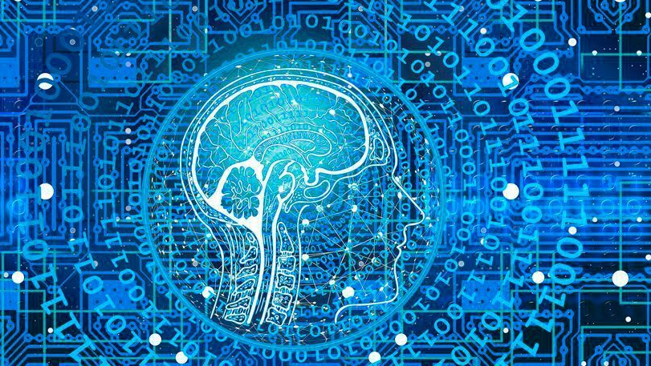
Phases of data mining
Business Understanding - To get started, ask questions. Without a clear understanding of the proper data to mine, the project can produce errors, inaccurate results, or results that don’t answer the correct questions.
Data Understanding – The next step is to collect the proper data. The data must be relevant to subject matter. The goal in this phase is to ensure the data correctly encompasses all necessary data sets to address the objective.
Data Preparation – “The most time-consuming phase, the preparation phase, consists of three steps: extraction, transformation, and loading. First, data is extracted from various sources and deposited into a staging area. Next, during the transformation step: the data is cleaned, null sets are populated, duplicative data is removed, errors are resolved, and all data is allocated into tables. In the final step, loading, the formatted data is loaded into the database for use.” (What is Data Mining?, 2022).

Slide 7
Phases of data mining cont.
Modeling – This phase selects the appropriate modeling technique for the data set. This includes clustering, predictive models, classification, estimation or a combination of these techniques.
Evaluation - After the models are built and tested, it’s time to evaluate their efficiency in answering the question presented in the first phase.
Deployment - Once the data mining model is deemed accurate and successful in answering the objective question, it’s time to put it to use. Deployment can occur in the form of a visual presentation, or a report sharing insights and can lead to some sort of action from the business’ part.

Slide 8

conclusion
Data mining is the process of searching and analyzing a large batch of raw data to identify patterns and extract useful information.
Companies use data mining software to learn more about their customers.
It can help them to develop more effective marketing strategies, increase sales, and decrease costs.

Slide 9

Questions?

Slide 10
References
How Data Mining Works: A Guide. (n.d.). Tableau. https://www.tableau.com/learn/articles/what-is-data-mining
Twin, A. (2023, April 15). What Is Data Mining? How It Works, Benefits, Techniques, and Examples. Investopedia. https://www.investopedia.com/terms/d/datamining.asp#:~:text=Data%20mining%20is%20the%20process,increase%20sales%2C%20and%20decrease%20costs.
What Is Data Mining? A Beginner’s Guide (2022). (2022). Rutgers Bootcamps. https://bootcamp.rutgers.edu/blog/what-is-data-mining/#what

